Slide 1
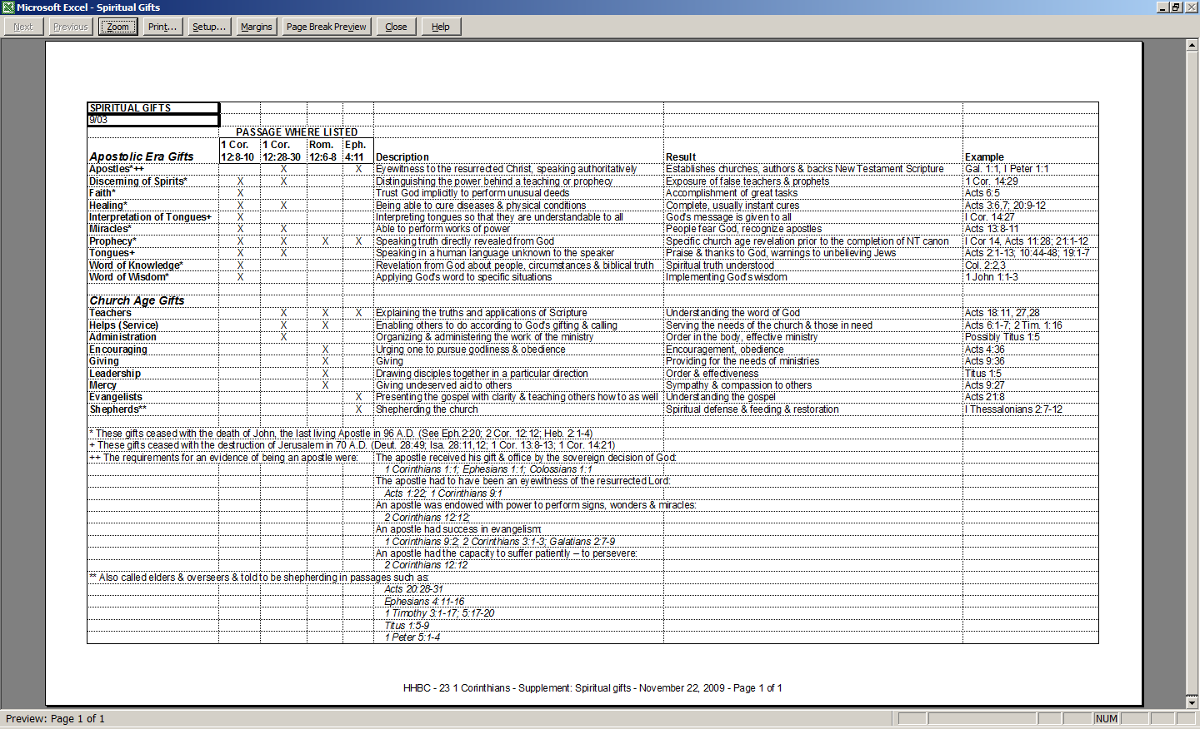

Slide 2
Are these all of the spiritual gifts?

Slide 3
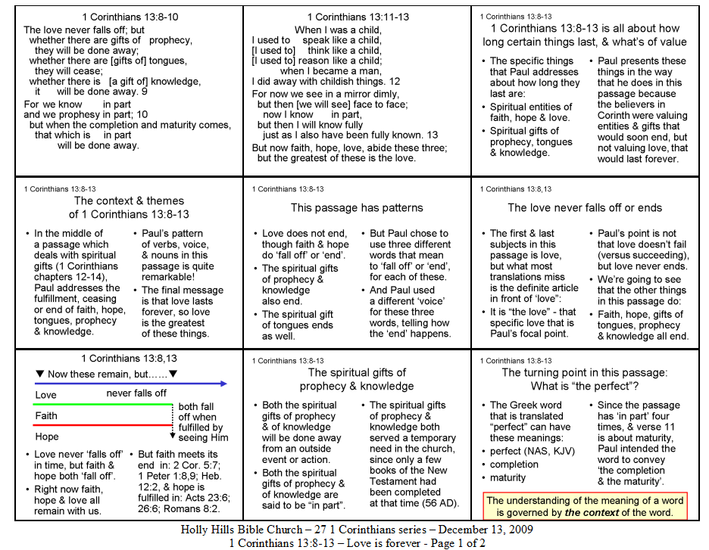

Slide 4
The first two slides on your handout show the passage in a poetic form, with some meanings from the Greek brought out by words to clarify our understanding, & implied meanings added by brackets [implied words]. We’ll be glancing back at these slides from time to time.

Slide 5
1 Corinthians 13:8-10
The love never falls off; but whether there are gifts of prophecy, they will be done away; whether there are [gifts of] tongues, they will cease; whether there is [a gift of] knowledge, it will be done away. 9
For we know in part and we prophesy in part; 10 but when the completion and maturity comes, that which is in part will be done away.
1

Slide 6
1 Corinthians 13:11-13
When I was a child, I used to speak like a child, [I used to] think like a child, [I used to] reason like a child; when I became a man, I did away with childish things. 12
For now we see in a mirror dimly, but then [we will see] face to face; now I know in part, but then I will know fully just as I also have been fully known. 13
But now faith, hope, love, abide these three; but the greatest of these is the love.
1

Slide 7
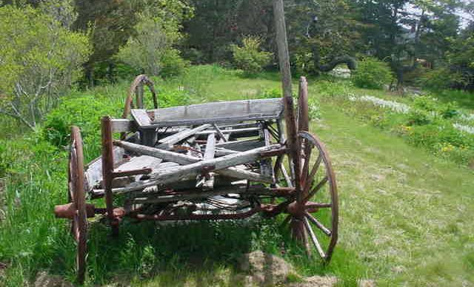
1 Corinthians 13:8-13 is all about how long certain things last, & what’s of value
1 Corinthians 13:8-13
1

Slide 8
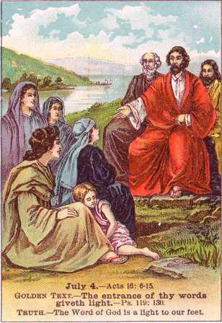
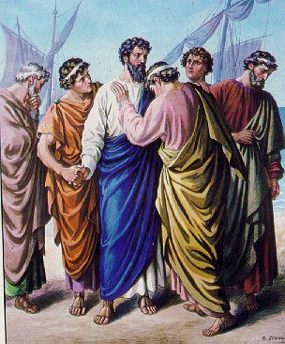
1 Corinthians 13:8-13 is all about how long certain things last, & what’s of value
1 Corinthians 13:8-13
The specific things that Paul addresses about how long they last are:
Spiritual entities of faith, hope & love.
Spiritual gifts of prophecy, tongues & knowledge.
1

Slide 9
1 Corinthians 13:8-10
The love never falls off; but whether there are gifts of prophecy, they will be done away; whether there are [gifts of] tongues, they will cease; whether there is [a gift of] knowledge, it will be done away. 9
For we know in part and we prophesy in part; 10 but when the completion and maturity comes, that which is in part will be done away.
1

Slide 10
1 Corinthians 13:11-13
When I was a child, I used to speak like a child, [I used to] think like a child, [I used to] reason like a child; when I became a man, I did away with childish things. 12
For now we see in a mirror dimly, but then [we will see] face to face; now I know in part, but then I will know fully just as I also have been fully known. 13
But now faith, hope, love, abide these three; but the greatest of these is the love.
1

Slide 11
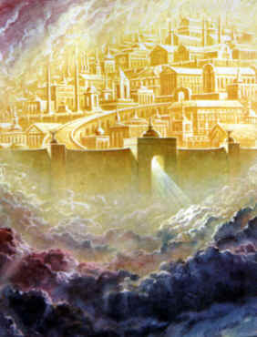
1 Corinthians 13:8-13 is all about how long certain things last, & what’s of value
1 Corinthians 13:8-13
Paul presents these things in the way that he does in this passage because the believers in Corinth were valuing entities & gifts that would soon end, but not valuing love, that would last forever.
1

Slide 12
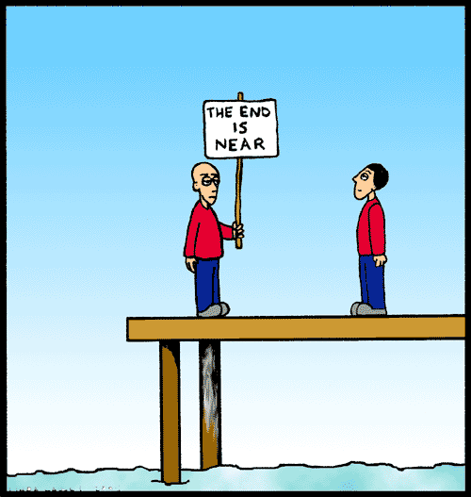
The context & themes of 1 Corinthians 13:8-13
1 Corinthians 13:8-13
In the middle of a passage which deals with spiritual gifts (1 Corinthians chapters 12-14), Paul addresses the fulfillment, ceasing or end of faith, hope, tongues, prophecy & knowledge.
Faith… Hope… Tongues… Prophecy… Knowledge…
1

Slide 13
The context & themes of 1 Corinthians 13:8-13
1 Corinthians 13:8-13
Paul’s pattern of verbs, voice, & nouns in this passage is quite remarkable!
The final message is that love lasts forever, so love is the greatest of these things.
1

Slide 14
This passage has patterns
1 Corinthians 13:8-13
1

Slide 15
This passage has patterns
1 Corinthians 13:8-13
1

Slide 16
This passage has patterns
1 Corinthians 13:8-13
1

Slide 17
This passage has patterns
1 Corinthians 13:8-13
Love does not end, though faith & hope do ‘fall off’ or ‘end’.
The spiritual gifts of prophecy & knowledge also end.
The spiritual gift of tongues ends as well.
1

Slide 18
This passage has patterns
1 Corinthians 13:8-13
But Paul chose to use three different words that mean to ‘fall off’ or ‘end’, for each of these.
And Paul used a different ‘voice’ for these three words, telling how the ‘end’ happens.
1

Slide 19
The love never falls off or ends
1 Corinthians 13:8,13
The first & last subject in this passage is love, but what most translations miss is the definite article in front of ‘love”:
It is “the love” - that specific love that is Paul’s focal point.
The LOVE
1

Slide 20
The love never falls off or ends
1 Corinthians 13:8,13
Paul’s point is not that love doesn’t fail (versus succeeding), but love never ends.
We’re going to see that the other things in this passage do:
Faith, hope, gifts of tongues, prophecy & knowledge all end.
1

Slide 21
The love never falls off or ends
1 Corinthians 13:8,13
Paul’s point is not that love doesn’t fail (versus succeeding), but love never ends.
We’re going to see that the other things in this passage do:
Faith, hope, gifts of tongues, prophecy & knowledge all end.
1

Slide 22
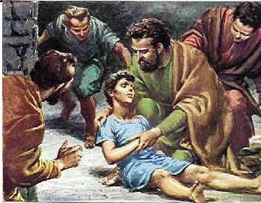
Eutychus fell out of the third story window (Acts 20:9)
“Love never fails…”

Slide 23
1 Corinthians 13:8,13
❑ Now these remain, but……
Love
never falls off
both fall off when fulfilled by seeing Him
Faith
Hope
Love never ‘falls off’ in time, but faith & hope both ‘fall off’.
Right now faith, hope & love all remain with us.
But faith meets its end in: 2 Cor. 5:7; 1 Peter 1:8,9; Heb. 12:2, & hope is fulfilled in: Acts 23:6; 26:6; Romans 8:2.

Slide 24
The spiritual gifts of prophecy & knowledge
1 Corinthians 13:8-13
Both the spiritual gifts of prophecy & of knowledge will be done away from an outside event or action.
Both the spiritual gifts of prophecy & of knowledge are said to be “in part”.
1

Slide 25
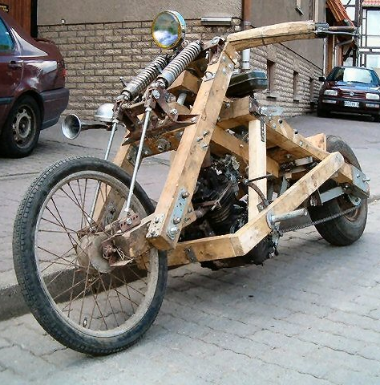
The spiritual gifts of prophecy & knowledge
1 Corinthians 13:8-13
The spiritual gifts of prophecy & knowledge both served a temporary need in the church, since only a few books of the New Testament had been completed at that time (56 AD).
Temporary Harley
1

Slide 26
The turning point in this passage: What is “the perfect”?
1 Corinthians 13:8-13
The Greek word that is translated “perfect” can have these meanings:
perfect (NAS, KJV)
completion
maturity
1

Slide 27
The turning point in this passage: What is “the perfect”?
1 Corinthians 13:8-13
Since the passage has ‘in part’ four times, & verse 11 is about maturity, Paul intended the word to convey ‘the completion & the maturity’.
The understanding of the meaning of a word is governed by the context of the word.
1

Slide 28
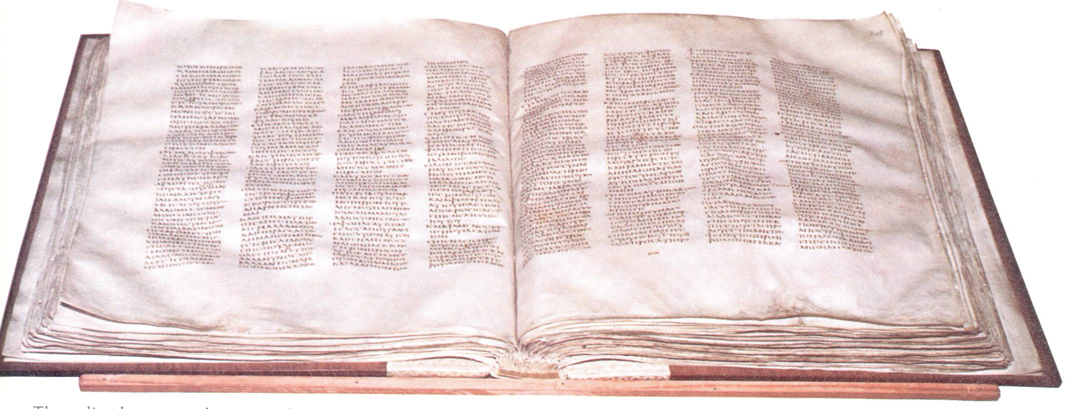
‘the completion and the maturity’
1 Corinthians 13:8-13
The completion of the New Testament would do away with the need for the gifts of prophecy & knowledge, which were ‘in part’, & that fulfilled a real, but temporary need in the church.
Codex Sinaiticus – the earliest complete New Testament still in existence.
2

Slide 29
1 Corinthians 13:11-13
When I was a child, I used to speak like a child, [I used to] think like a child, [I used to] reason like a child; when I became a man, I did away with childish things. 12
For now we see in a mirror dimly, but then [we will see] face to face; now I know in part, but then I will know fully just as I also have been fully known. 13
But now faith, hope, love, abide these three; but the greatest of these is the love.
1

Slide 30
1 Corinthians 13:11-13
When I was a child, I used to speak like a child, [I used to] think like a child, [I used to] reason like a child; when I became a man, I did away with childish things. 12
For now we see in a mirror dimly, but then [we will see] face to face; now I know in part, but then I will know fully just as I also have been fully known. 13
But now faith, hope, love, abide these three; but the greatest of these is the love.
⧫ tongues
⧫ knowledge
⧫ prophecy
1

Slide 31
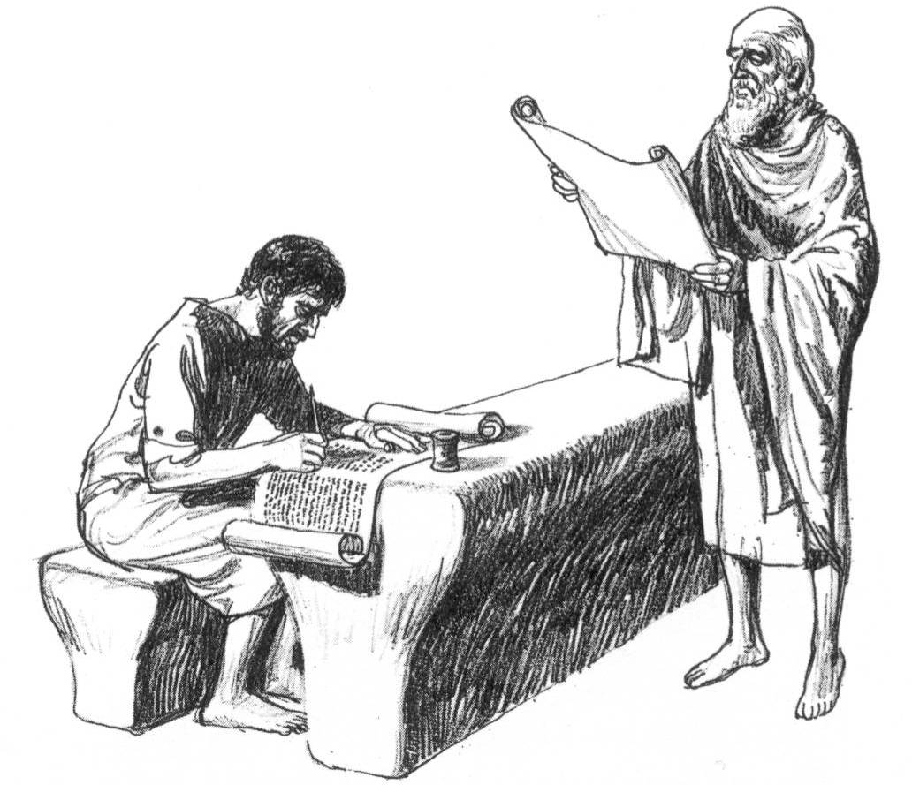
‘the completion and the maturity’
1 Corinthians 13:8-13
In verse 11 Paul’s point is that the church, by means of the completed word of God, would grow out of the need for the gifts that once fit, when the church was ‘like a child’, & do away with them.
2

Slide 32
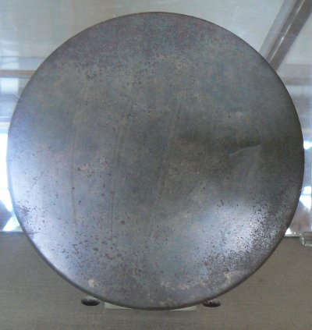
The mirror is not ‘smoke & mirrors’
1 Corinthians 13:12
Corinth was famous for its mirrors, so Paul drew upon that to represent the partially completed New Testament as through a mirror dimly - only about five of the books were completed.
They were missing: Most teaching on being identified with Christ. All of the teaching about being seated in, having citizenship in & setting one’s mind on the heavenlies. Blessed with every spiritual blessing.
2

Slide 33
Jude 3
…contend earnestly for the faith which was once for all handed down to the saints.
Revelation 22:18-19
I testify to everyone who hears the words of the prophecy of this book: if anyone adds to them, God will add to him the plagues which are written in this book; 19 and if anyone takes away from the words of the book of this prophecy, God will take away his part from the tree of life and from the holy city, which are written in this book.

Slide 34
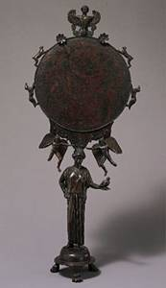
The mirror is not ‘smoke & mirrors’
1 Corinthians 13:12
But the other uses of ‘mirror’ in the New Testament also represented the written word of God (see also 2 Corinthians 3:18 & James 1:22-24).
The complete New Testament clarifies.
2

Slide 35
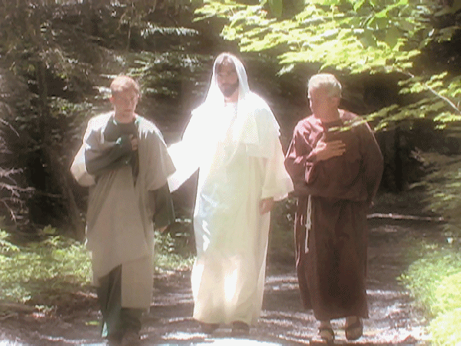
From ‘through a mirror dimly’ to seeing ‘face to face’
1 Corinthians 13:12
The New Testament revealed so many things about Christ & about the church that were not at all revealed in the Old Testament.
The Old Testament is inspired, but the church needed more.
Then beginning with Moses and with all the prophets, He explained to them the things concerning Himself in.. [the Old Testament]
2

Slide 36
From ‘through a mirror dimly’ to seeing ‘face to face’
1 Corinthians 13:12
The New Testament revealed so many things about Christ & about the church that were not at all revealed in the Old Testament.
The Old Testament is inspired, but the church needed more.
…in Christ… … a new creature… …sealed with the Holy Spirit… …caught up… …not under law, but under grace… …apostles… …walk in the Spirit… …baptized into Christ…
2

Slide 37
From ‘through a mirror dimly’ to seeing ‘face to face’
1 Corinthians 13:12
2 Corinthians 3:18
But we all, with unveiled face, beholding as in a mirror the glory of the Lord, are being transformed into the same image from glory to glory, just as from the Lord, the Spirit.
While some view ‘face to face’ as our seeing Christ in heaven, the New Testament does not use it that way, & 2 Corinthians 3:18 is about our beholding Christ now through the word of God.
2

Slide 38
Tongues will cease of their own
1 Corinthians 13:8-13
The primary value & purpose of the gift of tongues will be separately fulfilled, as indicated by a different word that means ‘to end’, & not being called ‘in part’, as with the other two gifts.
2

Slide 39
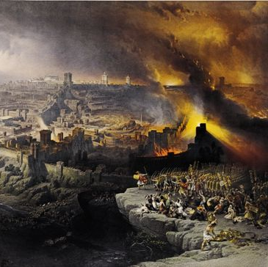
Tongues will cease of their own
1 Corinthians 13:8-13
Tongues, by the evidence of both the Old & New Testaments, had a special purpose that was fulfilled in 70 AD, when the Romans defeated Jerusalem, & valid tongues ceased.
2
Notes:
Deut 28:49: “The Lord will bring a nation against you from afar, from the end of the earth, as the eagle swoops down, a nation whose language you shall not understand”
Is 28:11: “Indeed, He will speak to this people Through stammering lips and a foreign tongue,”

Slide 40
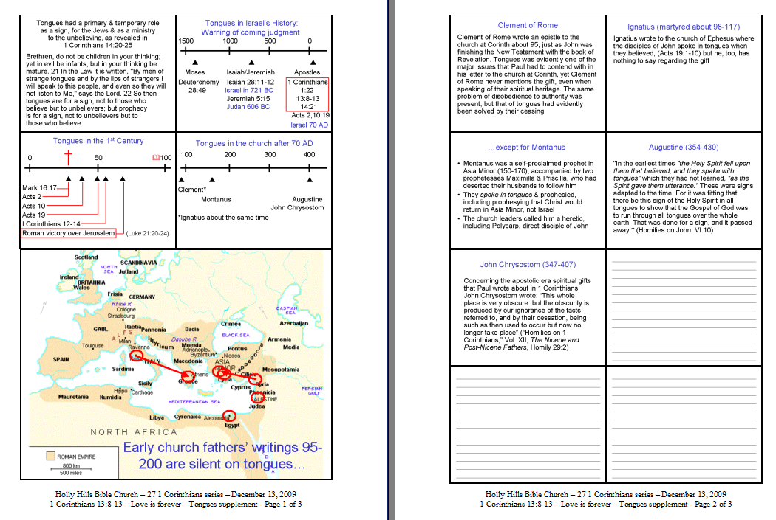

Slide 41
1 Corinthians 13:8-13
❑ Now these remain, but……
Love
never falls off
both fall off when fulfilled by seeing Him
Faith
Hope
2

Slide 42
1 Corinthians 13:8-13
❑ Now these remain, but……
Love
never falls off
both fall off when fulfilled by seeing Him
Faith
Hope
Prophecy & Knowledge  
both are done away by the completion of the New Testament
~96 AD
2

Slide 43
1 Corinthians 13:8-13
❑ Now these remain, but……
Love
never falls off
both fall off when fulfilled by seeing Him
Faith
Hope
Prophecy & Knowledge  
both are done away by the completion of the New Testament
Tongues
ceases of its own by 70 AD
~96 AD
2

Slide 44
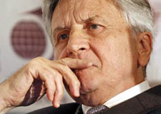
Is there any other confirmation that ‘the apostolic era gifts’ ended with the apostles?

Slide 45
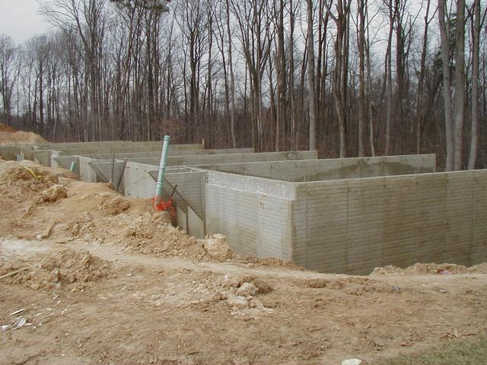
Ephesians 2:19-20:
…you are fellow citizens with the saints, and are of God's household, 20 having been built on the foundation of the apostles and prophets, Christ Jesus Himself being the corner stone,
See also Ephesians 3:5 & 4:11.
A foundation serves to make a good start on a building, but one does not keep on building with more & more & more of the foundation.
2

Slide 46
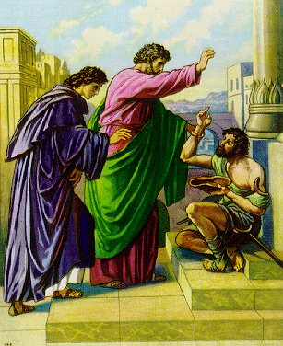
Hebrews 2:3-4:
“…it was at the first spoken through the Lord, it was confirmed to us by those who heard, 4 God also testifying with them, both by signs and wonders and by various miracles and by gifts of the Holy Spirit according to His own will.
Acts 3:1-10
So then, does He who provides you with the Spirit and works miracles among you, do it by the works of the Law, or by hearing with faith? - Paul, in Galatians 3:5
2 Corinthians 2:12
2

Slide 47
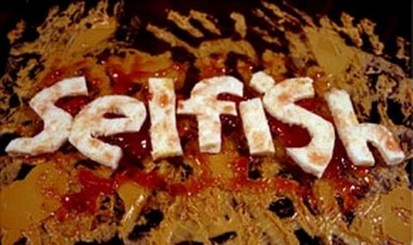
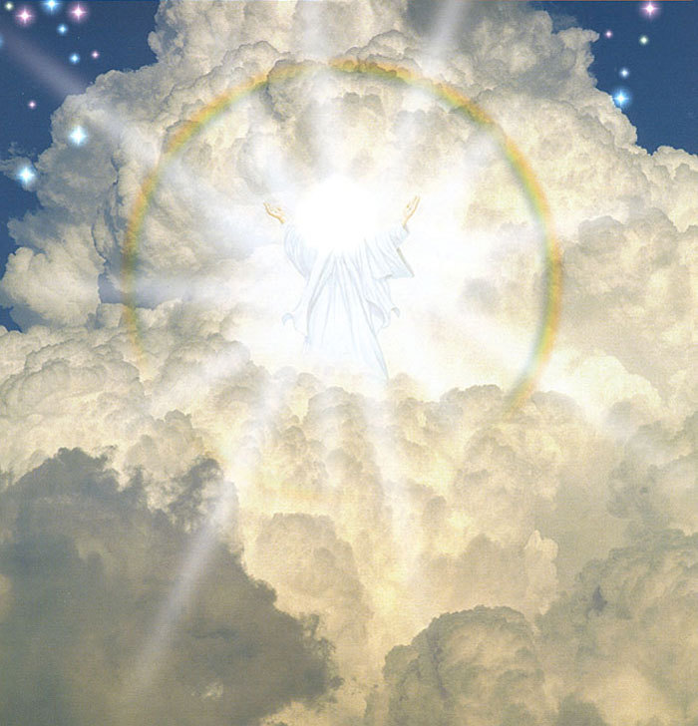
Spiritual gifts are for ministry in the church, to express God’s love through us to others
1 Corinthians 13:8-13
Those spiritually disoriented saints in Corinth were looking at their spiritual gifts as a tool to make them each look better here & now, but God had eternity in mind.
2

Slide 48
Spiritual gifts are for ministry in the church, to express God’s love through us to others
1 Corinthians 13:8-13
The spiritual gifts were intended by God to fulfill an earthly need of the church, toward an eternal & far more glorious purpose, & to be expressed in a love that would outlast the gifts.
2

Slide 49
So what do we ‘take home’ from this passage?
1 Corinthians 13:8-13
We ought to view our life here in view of eternity – some things are valuable & needed, but are intended by God to be temporary.
Of these things, the love is eternal, since it is God’s nature.
The ‘take home’ is about the love which will endure into our eternal home.
2

Slide 50
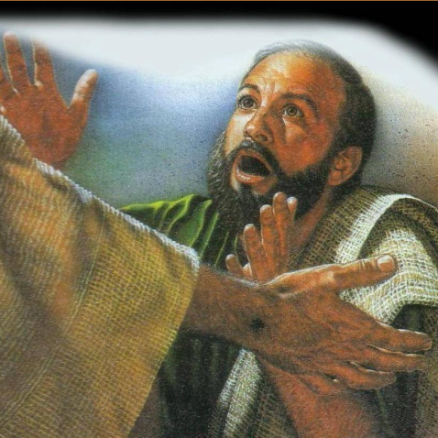
So what do we ‘take home’ from this passage?
1 Corinthians 13:8-13
But beholding the Lord Jesus Christ in the complete word of God, as in a mirror, is how we behold Him now, & God uses that to transform us from glory to glory (2 Corinthians 3:18).
2

Slide 51
Love is forever
“…so we shall always be with the Lord.” 1 Thessalonians 4:17

Slide 52
You Called Me By Name (1,2)
When I consider the work of Your fingers,
The sun and the stars,
The land and the sea;
I start to wonder, Almighty Creator,
Just why You would ever take thought of me.

Slide 53
You Called Me By Name
Chorus:
Yet You have called me by name,
You are acquainted with all of my ways;
Bought by Your blood, drawn by Your love,
I am Your dwelling place.
For you have called me Your friend,
Showing me favor, again and again;
I’m set apart, dear to Your heart,
You called me by name.

Slide 54
You Called Me By Name (1,2)
All of creation was made for Your pleasure,
The sun and the stars,
The land and the sea;
But by Your grace you have given me favor
With You I will reign for eternity.

Slide 55
You Called Me By Name
Chorus:
For You have called me by name,
You are acquainted with all of my ways;
Bought by Your blood, drawn by Your love,
I am Your dwelling place.
For you have called me Your friend,
Showing me favor, again and again;
I’m set apart, dear to Your heart,
You called me by name.

Slide 56
Things happening at HHBC: December & January
Christmas Program – December 20th
Christmas Eve Service – December 24th
See Bulletin, & the Needs & Opportunities Newsletter for details.
_______________________________________________________________
New electives – Beginning January 3rd, 2010.
Please sign up in the lobby.

