Slide 1
How to Study the Bible III
Week 35 – Acrostics & Psalms, Lamentations, Isaiah
Notes:
280 The Apostle Paul used verse 11 to remind the Corinthians that messages in tongues (foreign languages), far from being a sign of spirituality, indicate that the recipients are spiritually immature (1 Cor. 14:20-21). Likewise Isaiah revealed that when people are so spiritually dull that simple messages do not move them, God will teach them through experience.
See also '29 1 Corinthians 14....', page 1.
One thing to draw from Isaiah 28 is that line upon line, precept upon precept is not a biblical teaching model - these are words of warning to people, who like the Hebrews (Hebrews 5) are dull of hearing. Also, tongues is not the evidence of the baptism of the Holy Spirit, as my grandparents believed, but a warning, principally to the Jews from May 28, 33 AD to mid-70 AD. At that time, biblical tongues ceased of its own.

Slide 2
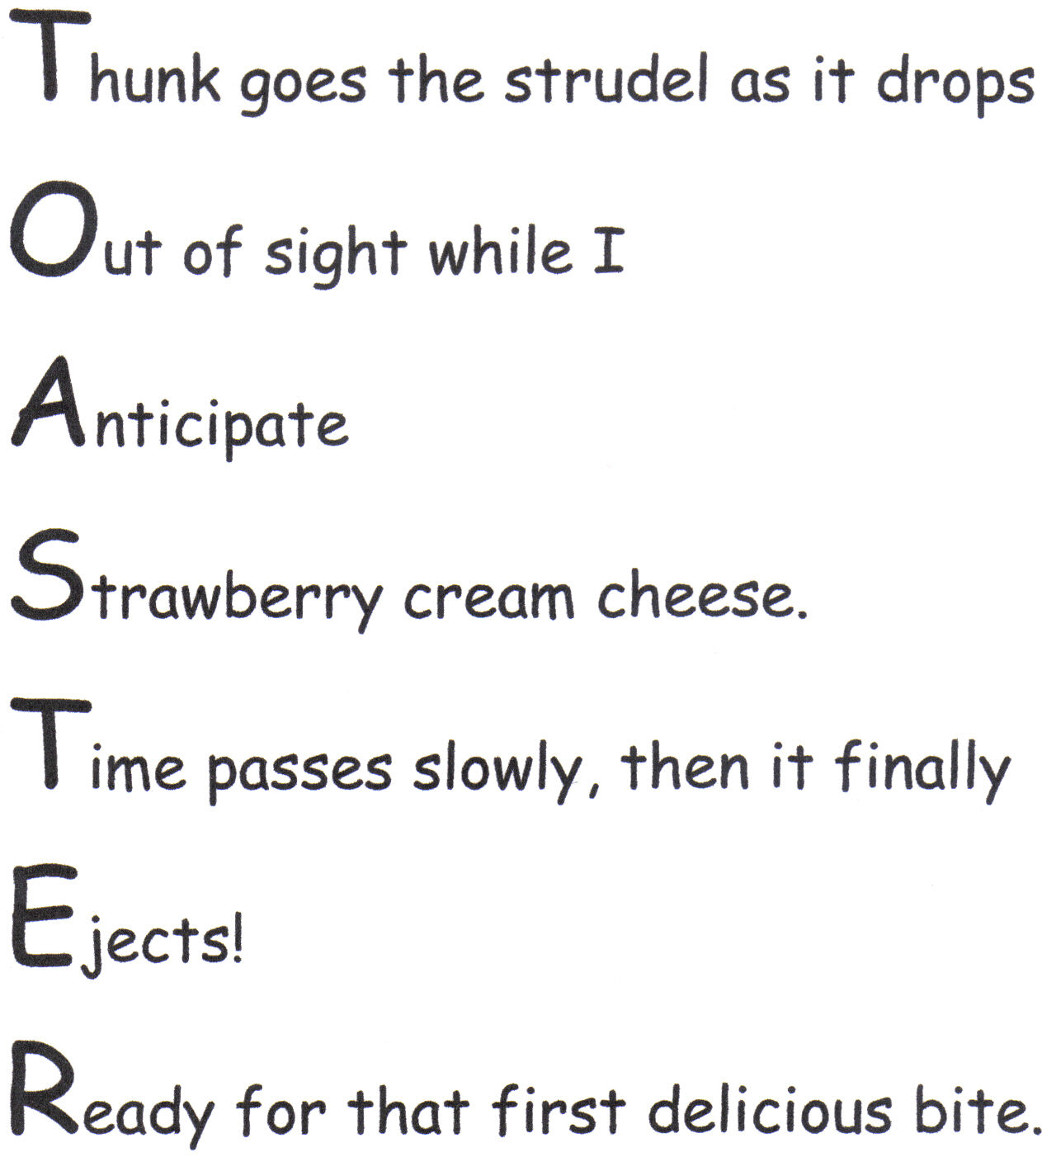
What’s an acrostic?
An acrostic is a poem (or other form of writing) in which the first letter (or syllable, or word) of each line (or paragraph, or other recurring feature in the text) spells out a word, message or the alphabet.

Slide 3
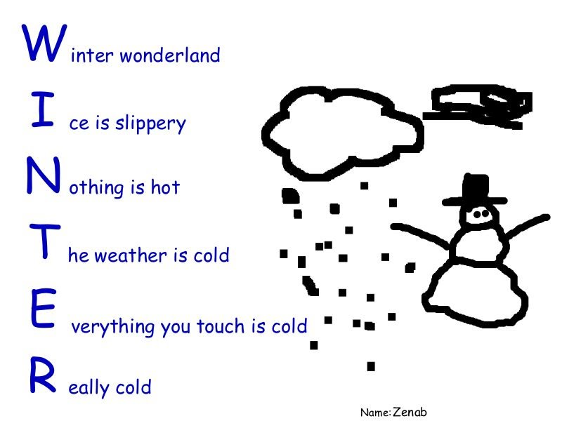
Most are pretty bad…. Why do we have ‘em?

Slide 4
Pedagogical mneumonics

Slide 5
… not just for kids....

Slide 6
An acrostic can add an organizing principle to seemingly disjointed concepts

Slide 7
An acrostic can add an organizing principle to seemingly disjointed concepts
It can also serve as a great cross-check when copying

Slide 8
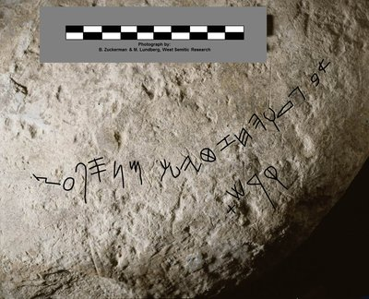
What’s an abecadery?
The most exciting find to come out of Tel Zayit recently is this abecedary, or linear alphabet carved in stone. The letters are outlined in black. (Photograph by Bruce Zuckerman and Marilyn J. Lundberg, West Semitic Research Project, University of Southern California)

Slide 9
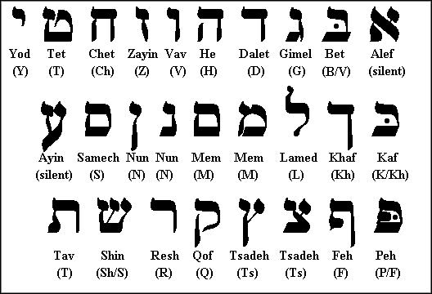
The Jewish Alphabet
Hebrew has been referred to by Jews as Leshon Hakodesh (לשון הקדש), "the Holy Language", since ancient times.
All letters have meaning and many times the first letter carries the weightier part of the meaning of the word.

Slide 10
Example: Aleph
Traditionally "first"; "sacrificial ox"; and "one thousand." As the first of all the holy Letters, and symbol of God's Oneness and Omnipotence, aleph is a three-in-one presentation. Its upper right segment consists of a yod, the first letter in the Name of the Divine. A second yod in the aleph's lower left segment signifies the Creator resident within His creation. The central diagonal connecting pillar is the vau, symbol of transformation. Aleph thus represents the process of spiritual transformation from human to super-human and is linked with the belief in absolute monotheism--that there is but one true living God.
* http://shekinah.elysiumgates.com/hebrew.html

Slide 11
Examples of acrostic passages & the alphabet
Psalms 111, 112
10 verses split into 22 sections
Each section begins with the next letter in the aleph-bet
Psalms 119
8 verses in each section with 22 sections
Each verse in each section begins with the same letter
Lamentations 1
22 verses
Each verse in each section begins with the next letter in the aleph-bet
Proverbs 31:10-31
22 verses
Each verse in each section begins with the next letter in the aleph-bet

Slide 12
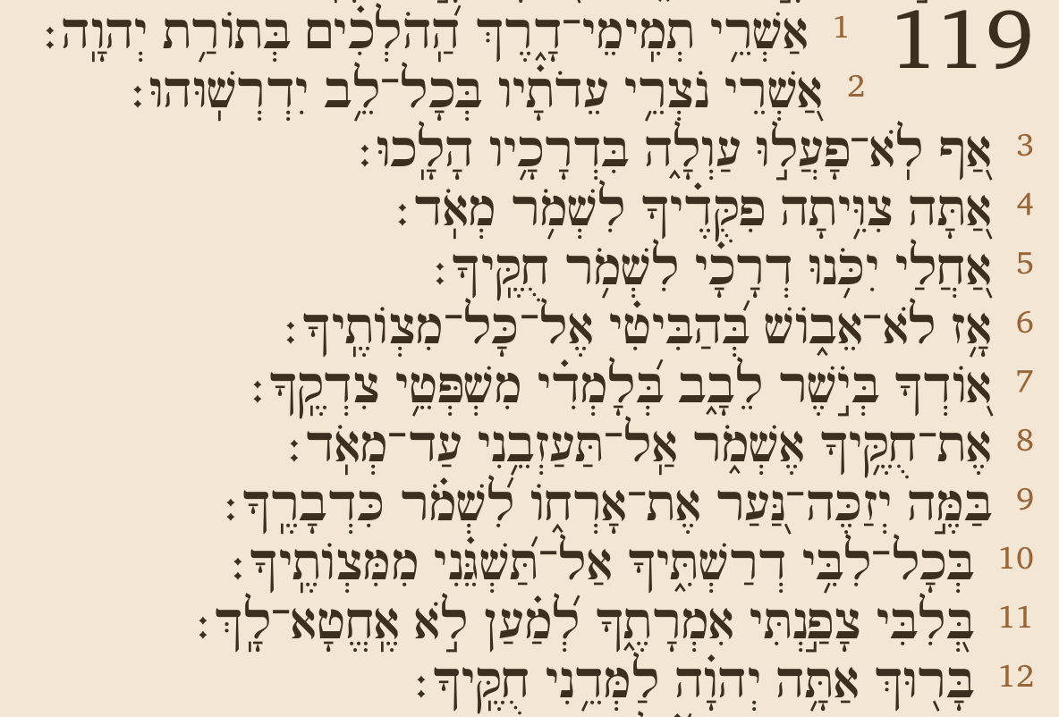

Slide 13
Easter egg in Isaiah 28:9-13
“To whom would He teach knowledge, And to whom would He interpret the message? Those just weaned from milk? Those just taken from the breast?“ For He says,‘ Order on order, order on order, Line on line, line on line, A little here, a little there.’” Indeed, He will speak to this people. Through stammering lips and a foreign tongue, He who said to them, “Here is rest, give rest to the weary,” And, “Here is repose,” but they would not listen. So the word of the Lord to them will be, “Order on order, order on order, Line on line, line on line, A little here, a little there,” That they may go and stumble backward, be broken, snared and taken captive.
Notes:
280 The Apostle Paul used verse 11 to remind the Corinthians that messages in tongues (foreign languages), far from being a sign of spirituality, indicate that the recipients are spiritually immature (1 Cor. 14:20-21). Likewise Isaiah revealed that when people are so spiritually dull that simple messages do not move them, God will teach them through experience.
See also '29 1 Corinthians 14....', page 1.
One thing to draw from Isaiah 28 is that line upon line, precept upon precept is not a biblical teaching model - these are words of warning to people, who like the Hebrews (Hebrews 5) are dull of hearing. Also, tongues is not the evidence of the baptism of the Holy Spirit, as my grandparents believed, but a warning, principally to the Jews from May 28, 33 AD to mid-70 AD. At that time, biblical tongues ceased of its own.

